Slide 1
Day 1 : part II R101: R coding

Slide 2
Keyboard shortcuts in RStudio
Console
Description | Windows & Linux | Mac
Move cursor to Console | Ctrl+2 | Ctrl+2
Clear console | Ctrl+L | Ctrl+L
Move cursor to beginning of line | Home | Command+Left
Move cursor to end of line | End | Command+Right
Navigate command history | Up/Down | Up/Down
Popup command history | Ctrl+Up | Command+Up
Interrupt currently executing command | Esc | Esc
Change working directory | Ctrl+Shift+H | Ctrl+Shift+H
Completions (Console and Source)
Description | Windows & Linux | Mac
Attempt completion | Tab or Ctrl+Space | Tab or Command+Space
Navigate candidates | Up/Down | Up/Down
Accept selected candidate | Enter, Tab, or Right | Enter, Tab, or Right
Dismiss completion popup | Esc | Esc

Slide 3
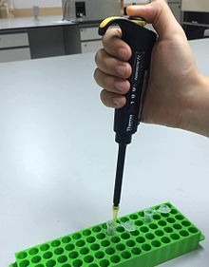
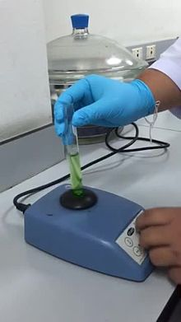

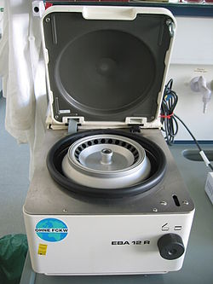
What is in the R code/function ?
Variables
Assignment operator
Arithmetic and logical operators
Data types
Object types
Control statements
Input/output (IO)
Comments
The actual work

Slide 4
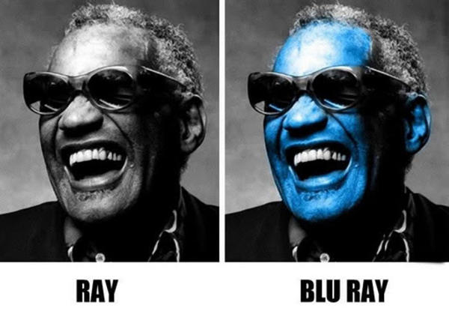
What exactly we do in R?
Variables & the assignment operator
A variable is a word or name in R code that has assigned numerical or other data. And, by using that word you can use the all numerical data assigned with. It is an identity that you give to data.
Example :
x <- 1
x = 1
y = 2
z <- 3
In R, you can assign value to a word by assignment operators
= or <-
Any data can be assigned to a variable name. Tables, lists, paragraphs, urls etc.
Variable names shall be intuitive and it should reflect some ideas about the data it has. For example, “raw.data” can reflect raw metabolomics and “raw.data.norm” can reflect normalized data matrix. Better and intuitive names helps us in understanding the codes after ten days.

Slide 5
Exercise 2 : Variables in R
Type these commands in the Rstudio console.
x <- 3 # x is 3
x
print(x) # print x in the console
x+2 # what is x plus 2
y <- 4 # y is 4
x+y # what is x plus y
x = 6 # we change the value of x to 6
x+y # now what is x plus y
height <- 1.80
weight <- 100
bmi <- weight/(height)^2

Slide 6
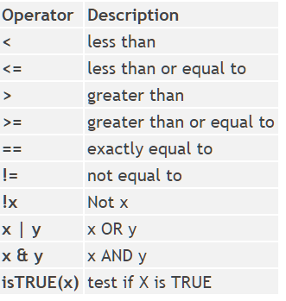
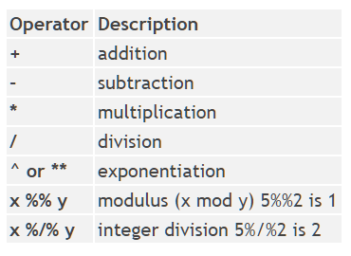
What we do in R?
Arithmetic operator
Logical operator

Slide 7
Exercise 3 : Let’s do some math and logical
Math
Logical
1>2
2>1
2<=2
2==1
2!=1
2!=1|2>1
x>y
y>x
1+2
1-3
45/6
456*3.2
4^5
5%%6

Slide 8
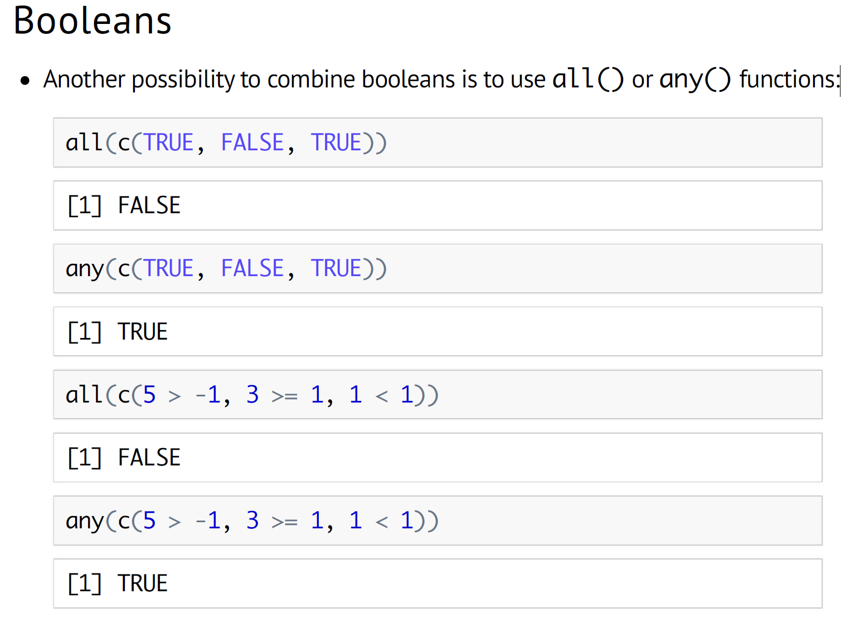

Slide 9
What we do in R?
Data types
Integer
1,2,3,4,5
Numeric
1.2, 1.0, 2.3, 4.5
Character
“A”, “An”, “The”, “Metabolomics”, “R is awesome”
Factors (categories)
“male” & “female”

Slide 10
Exercise 4 : Data Types
x <- 1
y <- 2.1
z <- “metabolomics”
zz <- “metabolomics is cool”
a1 <- “1”
x+1
x+z
a1+1
as.integer(a1)+1
as.character(x)
typeof(x)

Slide 11

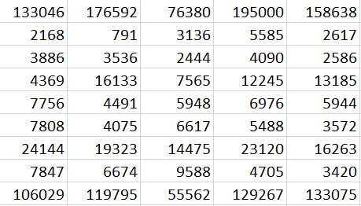
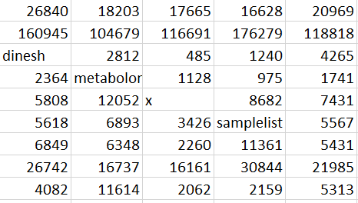
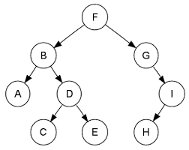
What we do in R?
Object types
vectors
matrix
data.frame
lists
More than one type of data
only one type of data. Numeric or character
Factors

Slide 12
Exercise 5 : Let’s create vectors
> c(5,6,7,1,2,3)
[1] 5 6 7 1 2 3
Index
1st Element
Length = 6

Slide 13
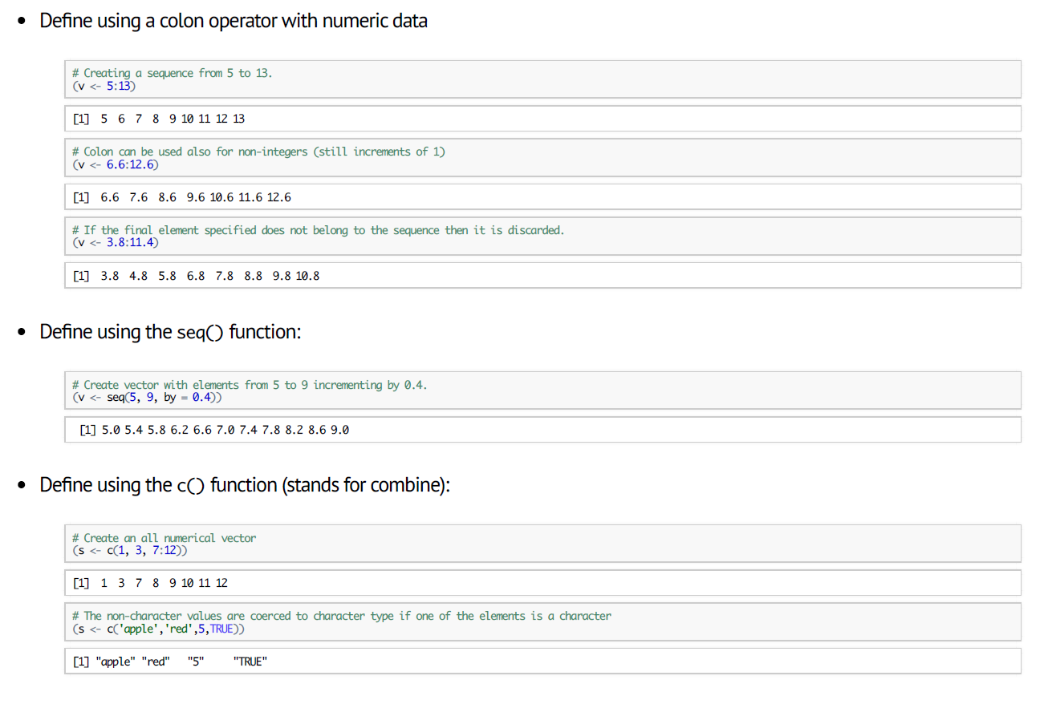

Slide 14
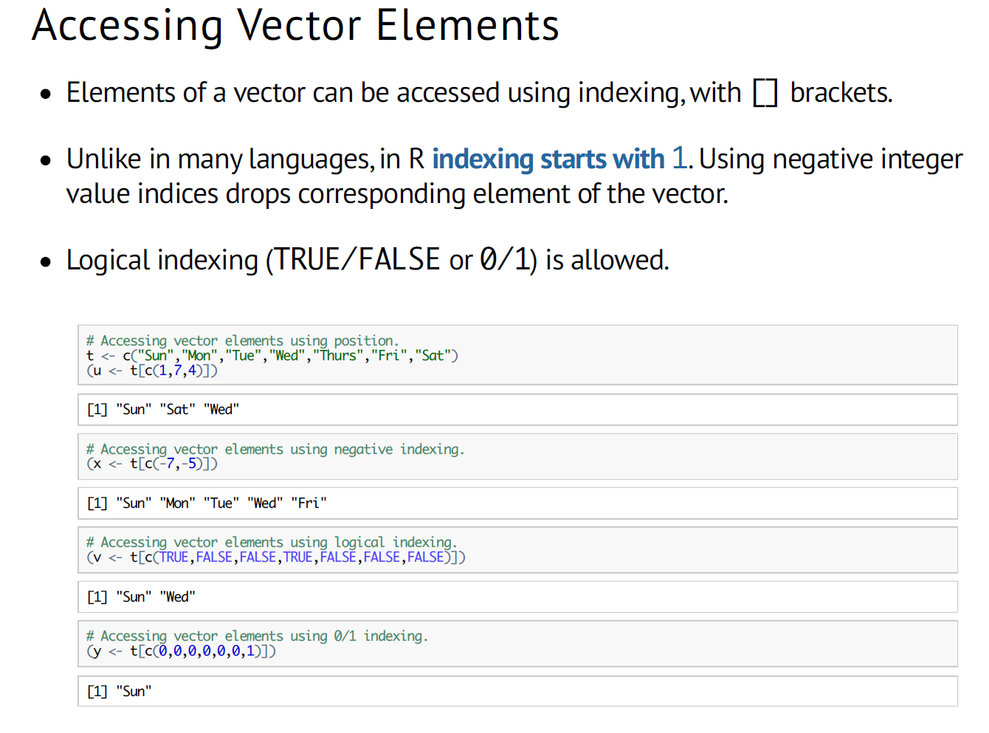

Slide 15
Select elements with a pattern
cpds <- c("xx_a", "xx_b”, "xx_c", "xx_d", "yy_a", "yy_b")
grep(“^xx",cpds)
cpds[-grep(“^xx",cpds)]
length(cpds[-grep(“^xx",cpds)])
cpds[grep(“^xx”,cpds)]
length(cpds[grep(“^xx”,cpds)])

Slide 16
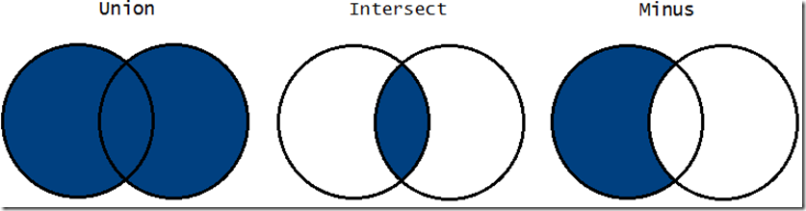
Vector set operators
x <- c(sort(sample(1:20, 9)),NA)
y <- c(sort(sample(3:23, 7)),NA)
union(x, y)
intersect(x, y)
setdiff(x, y)
setdiff(y, x)
setequal(x, y)

Slide 17
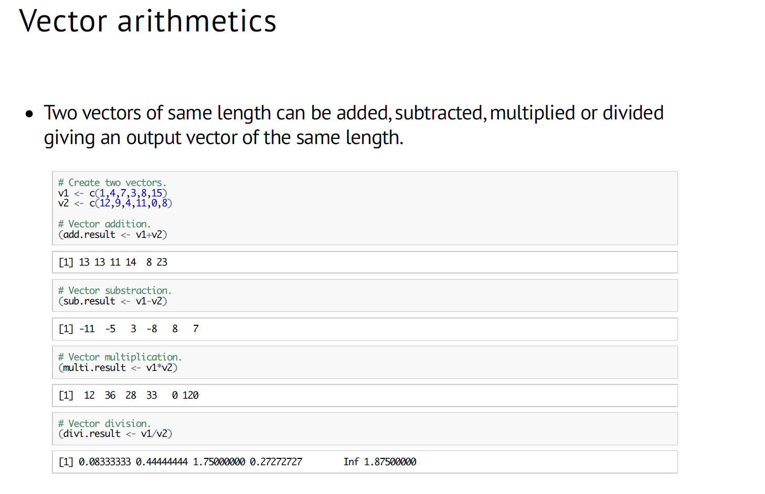

Slide 18
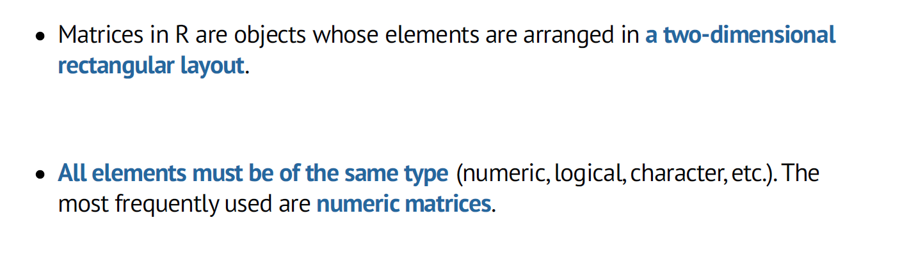
Exercise 6 : Let’s create matrices

Slide 19
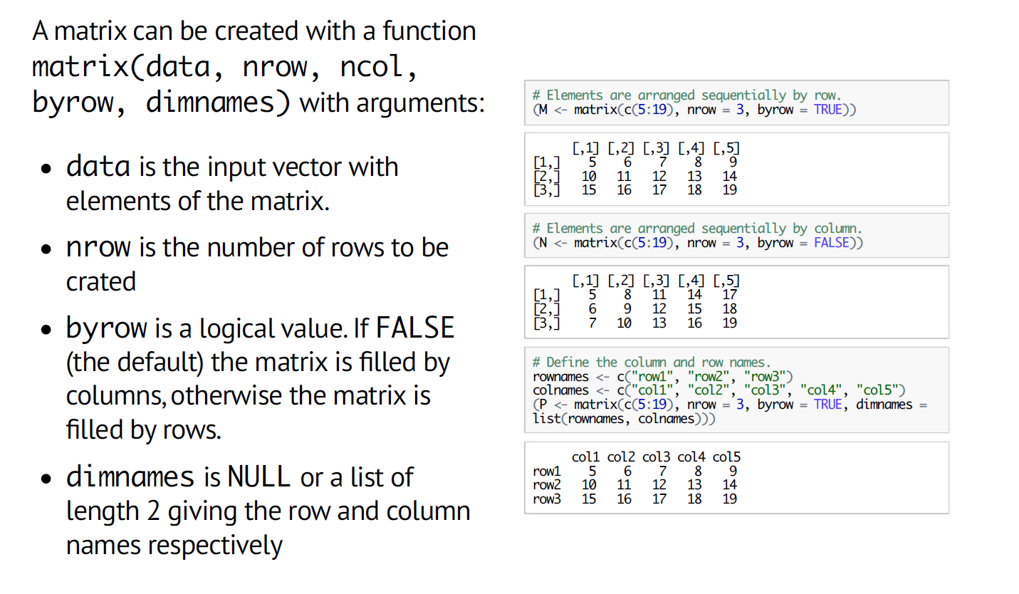

Slide 20
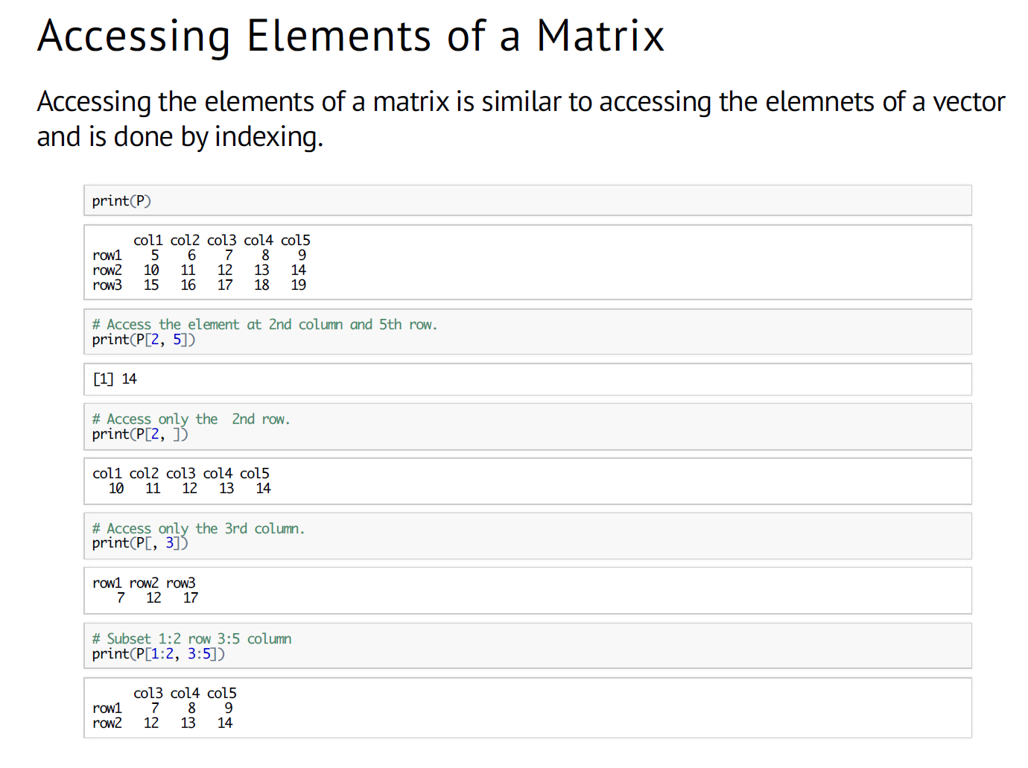

Slide 21
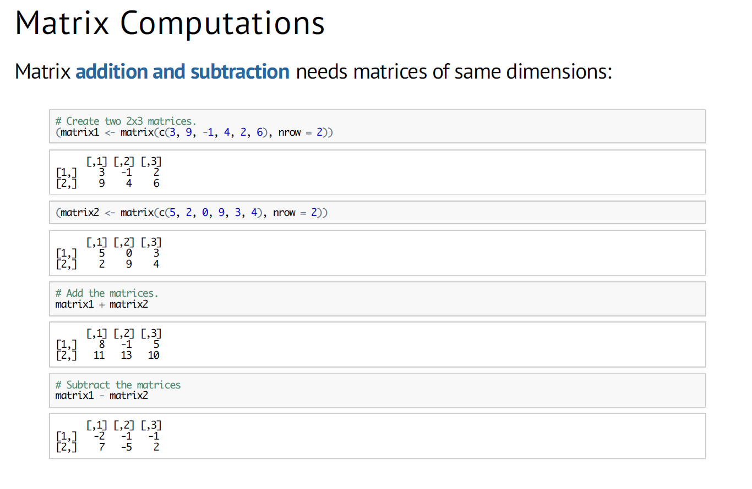

Slide 22
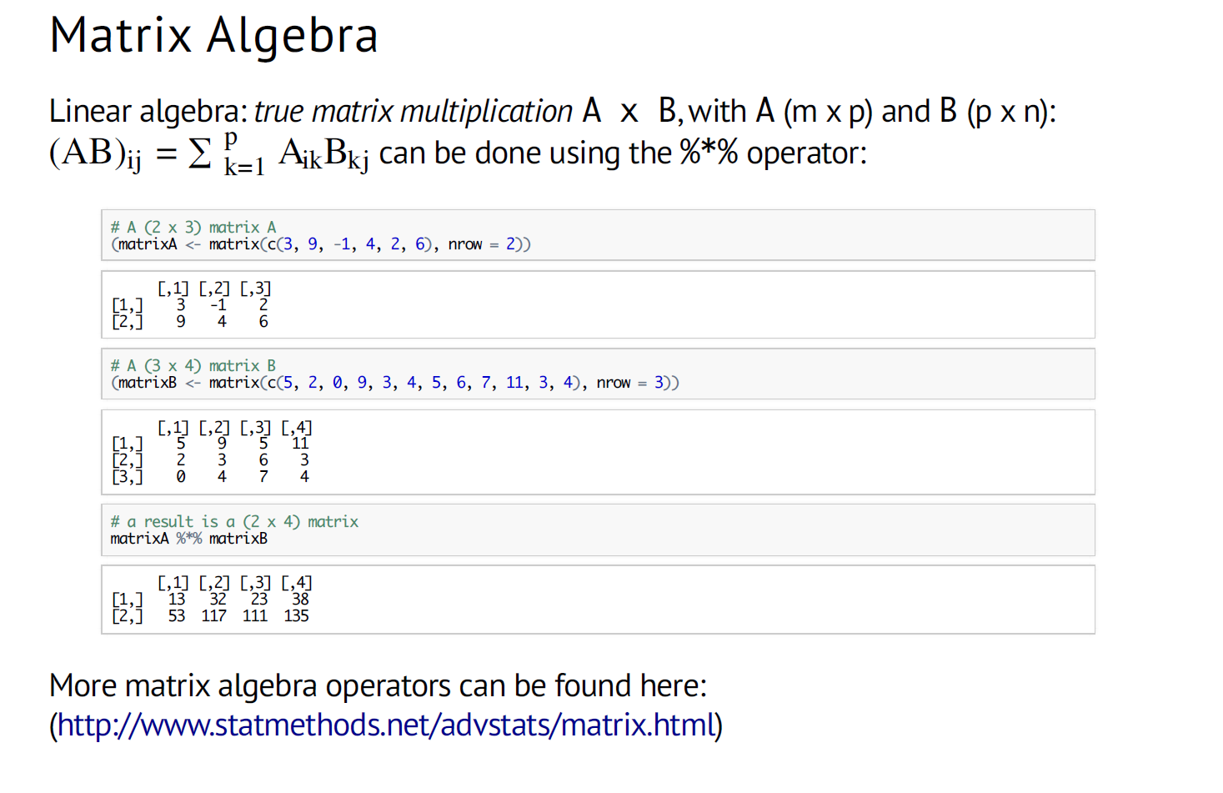

Slide 23
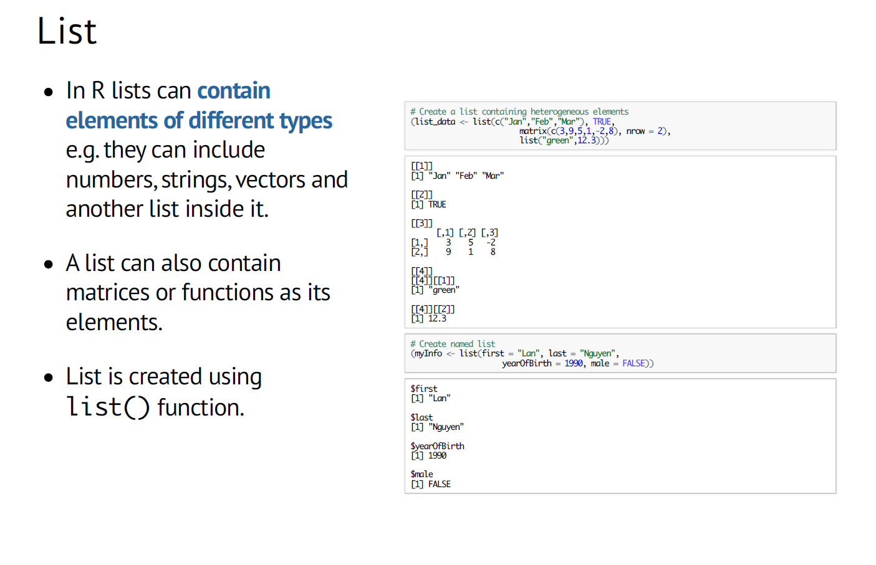
Exercise 7 : Let’s create lists

Slide 24
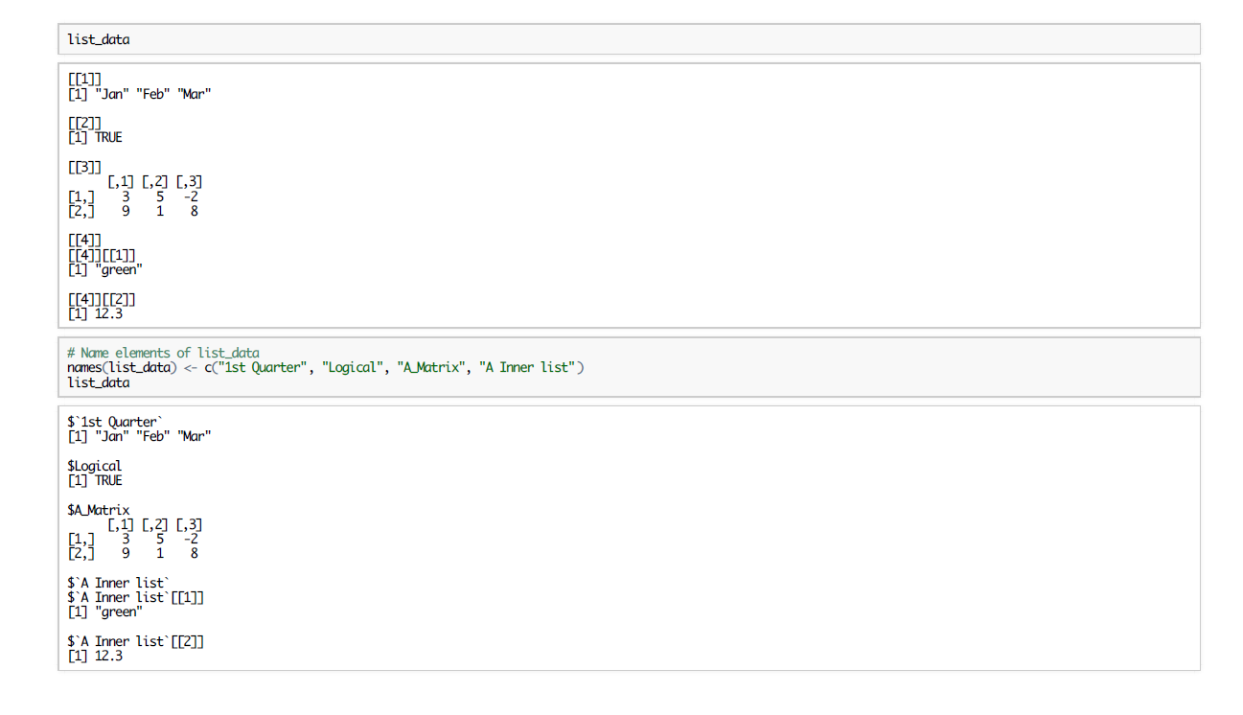

Slide 25
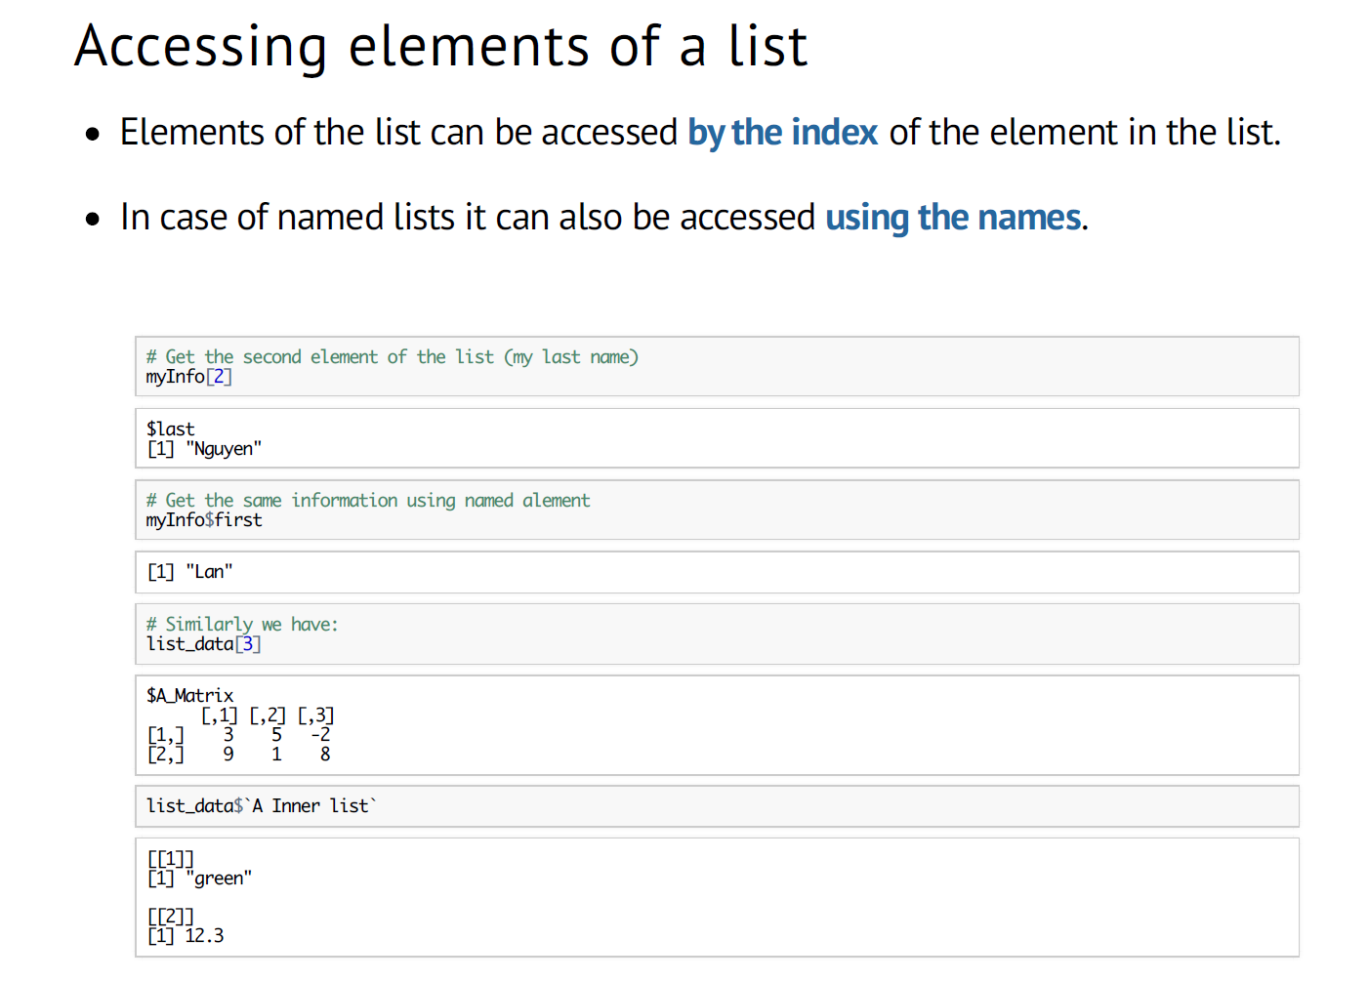

Slide 26
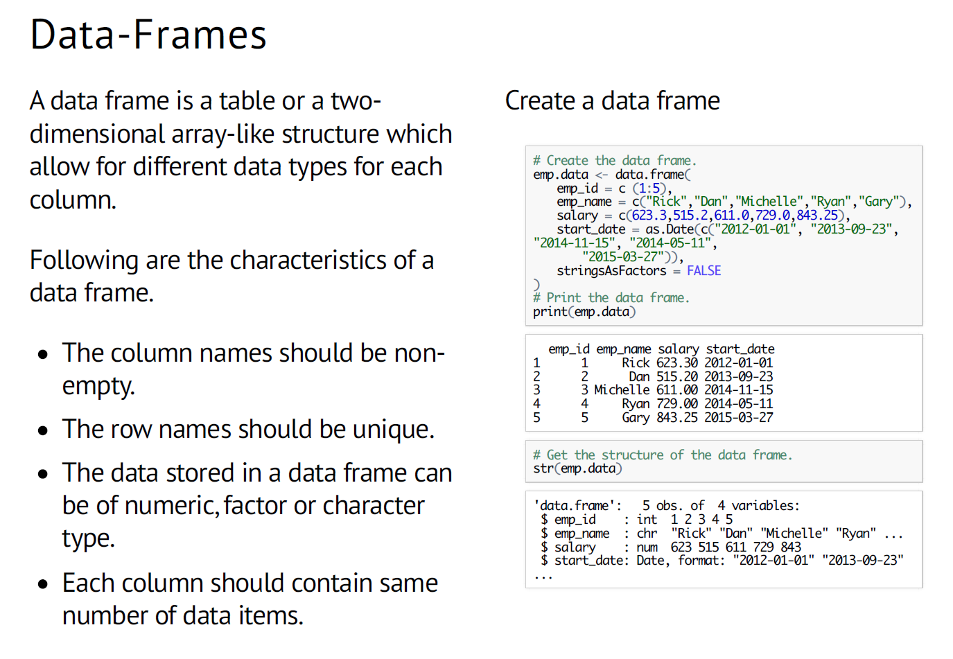
Exercise 7 : Let’s create data.frames

Slide 27
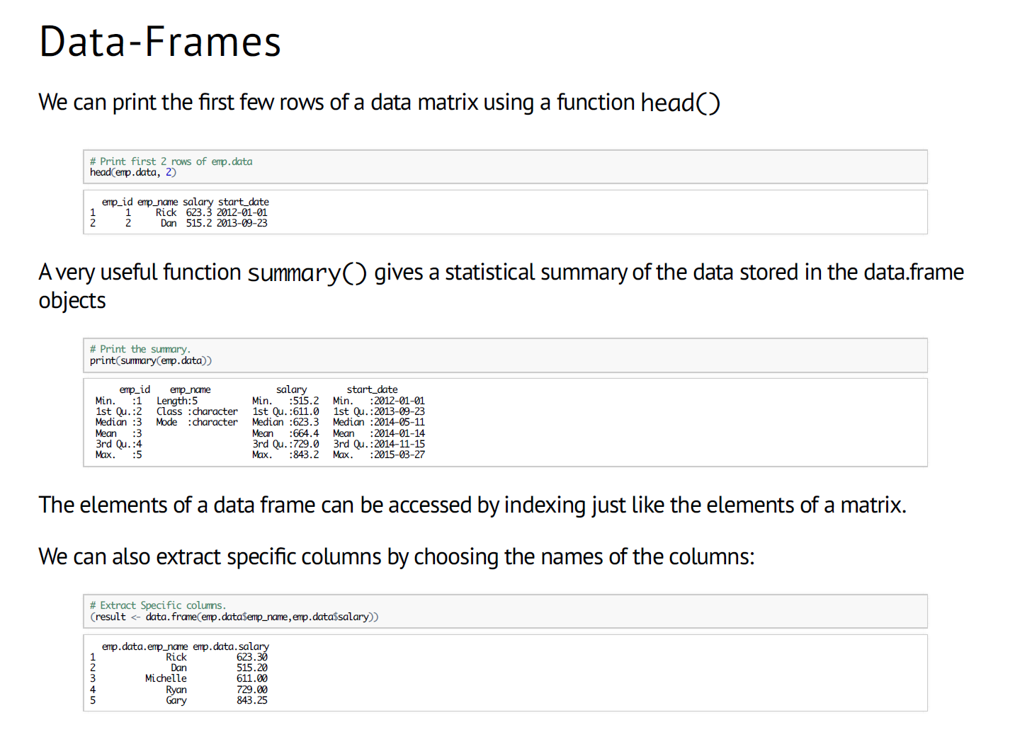

Slide 28
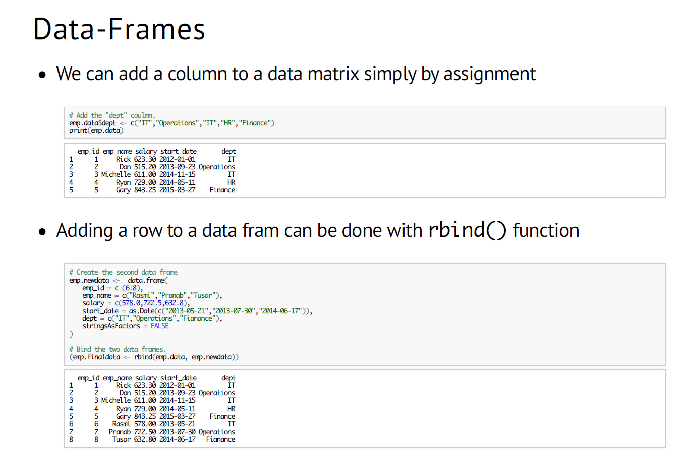

Slide 29
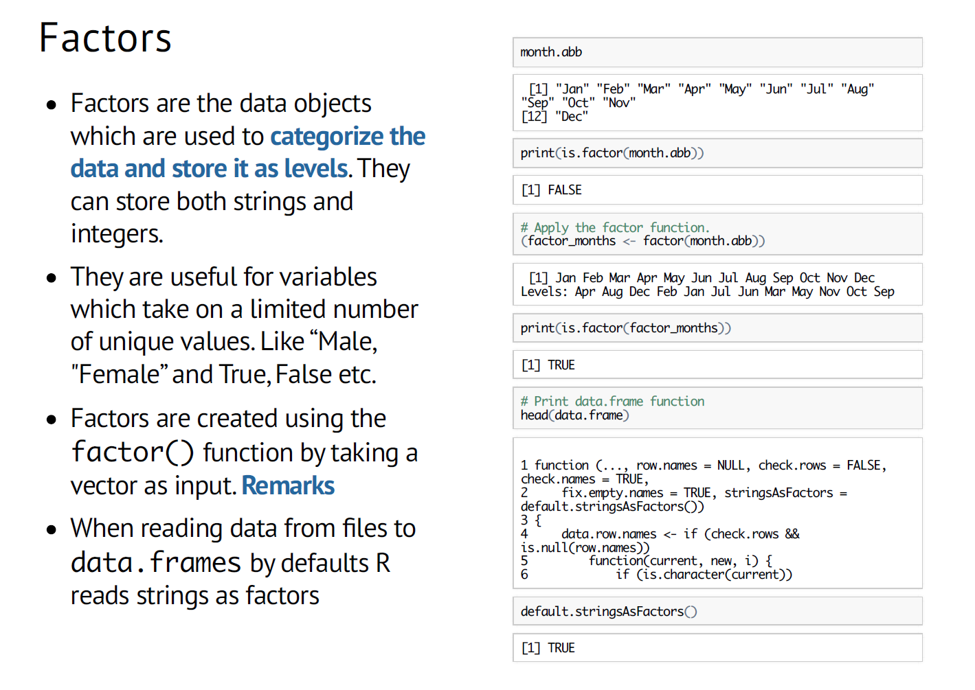
Exercise 8 : Let’s create factors

Slide 30
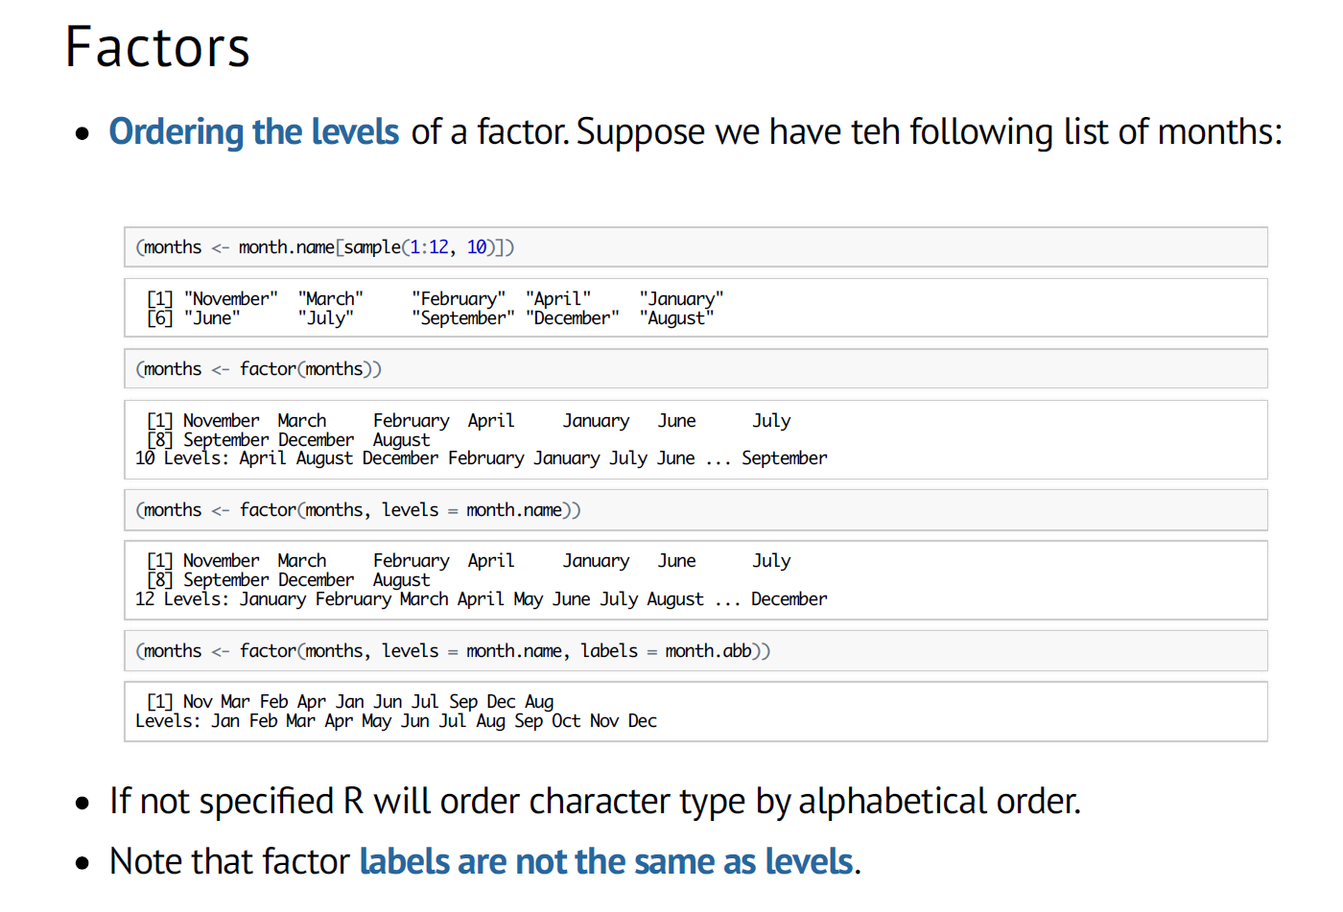

Slide 31
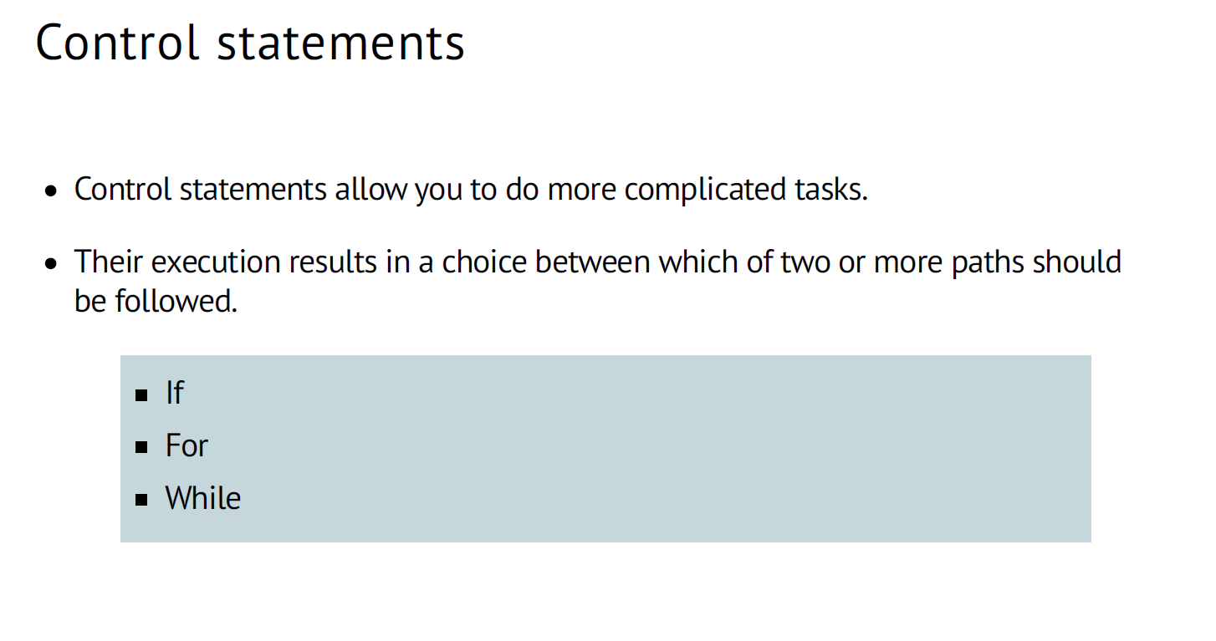

Slide 32
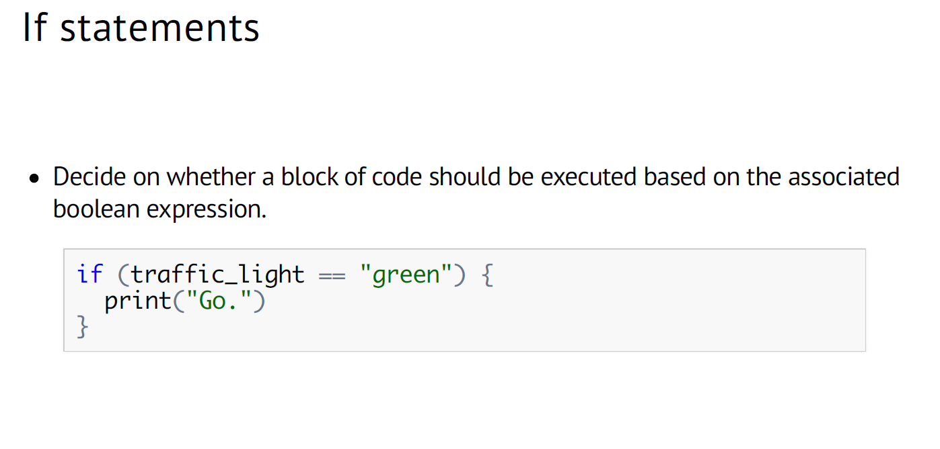
traffic_light <- “green”

Slide 33
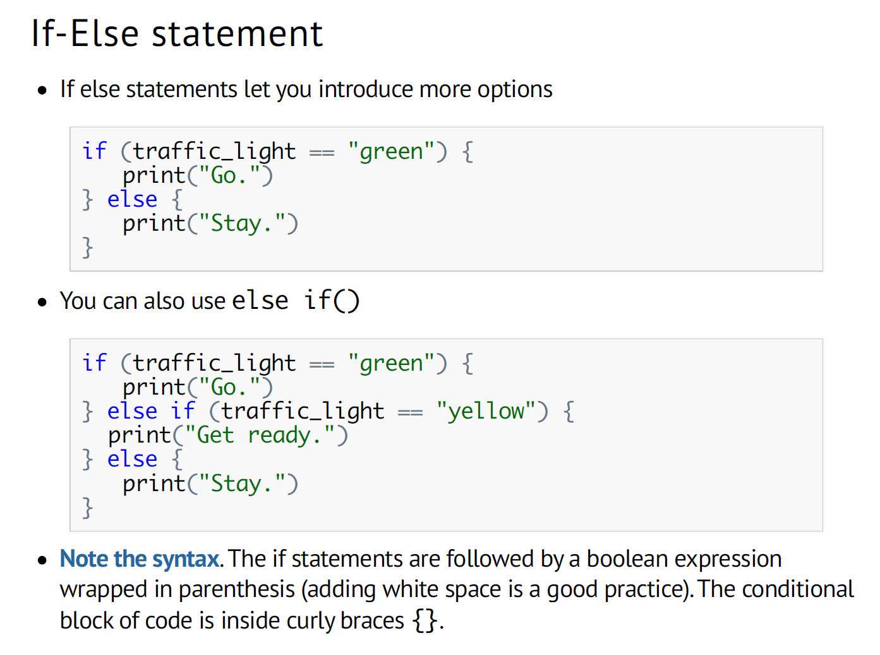
traffic_light <- “yellow”

Slide 34
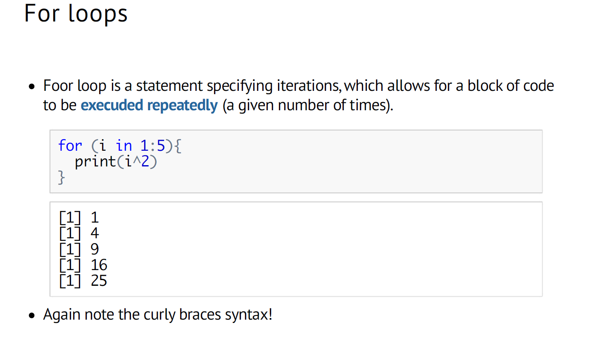

Slide 35
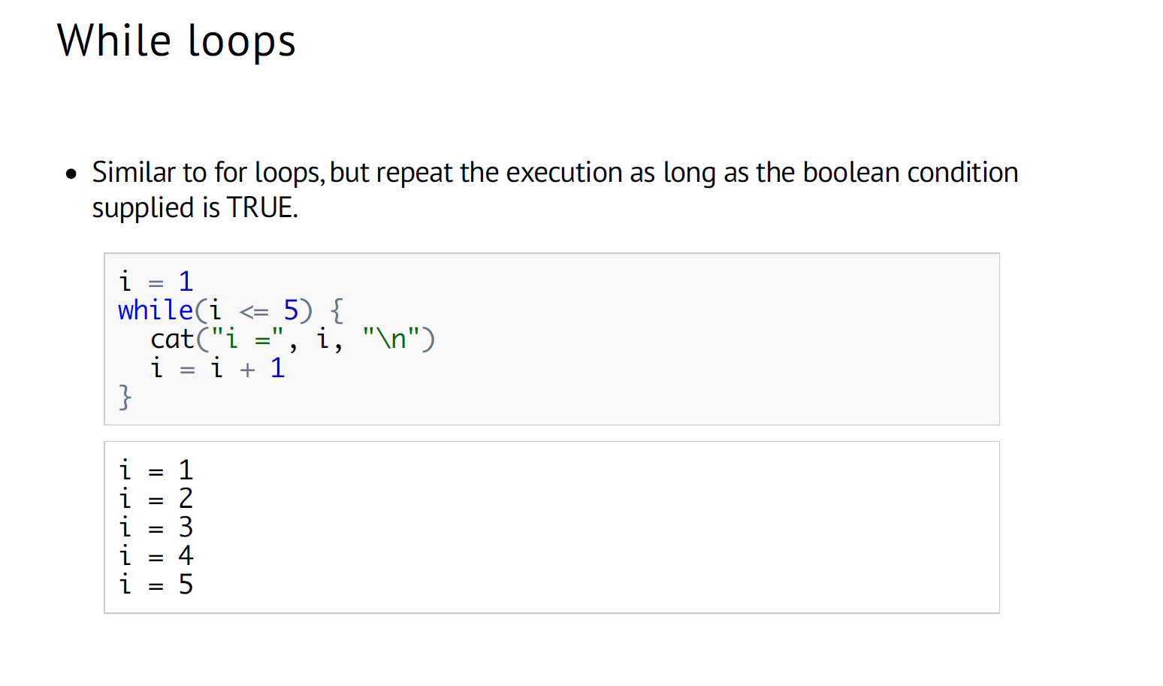

Slide 36
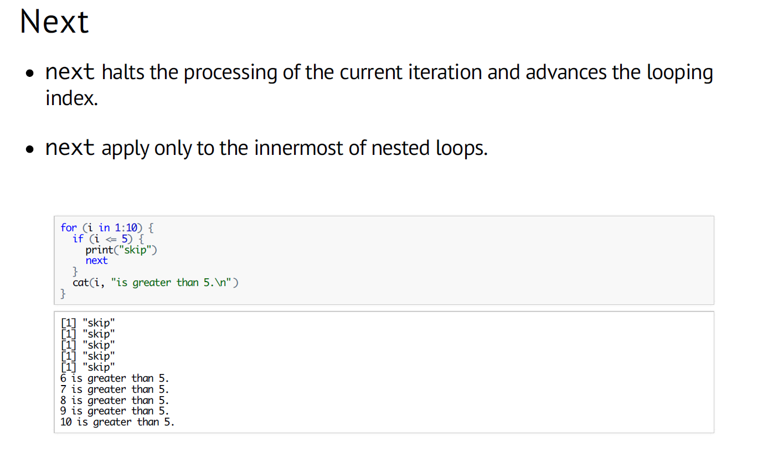

Slide 37
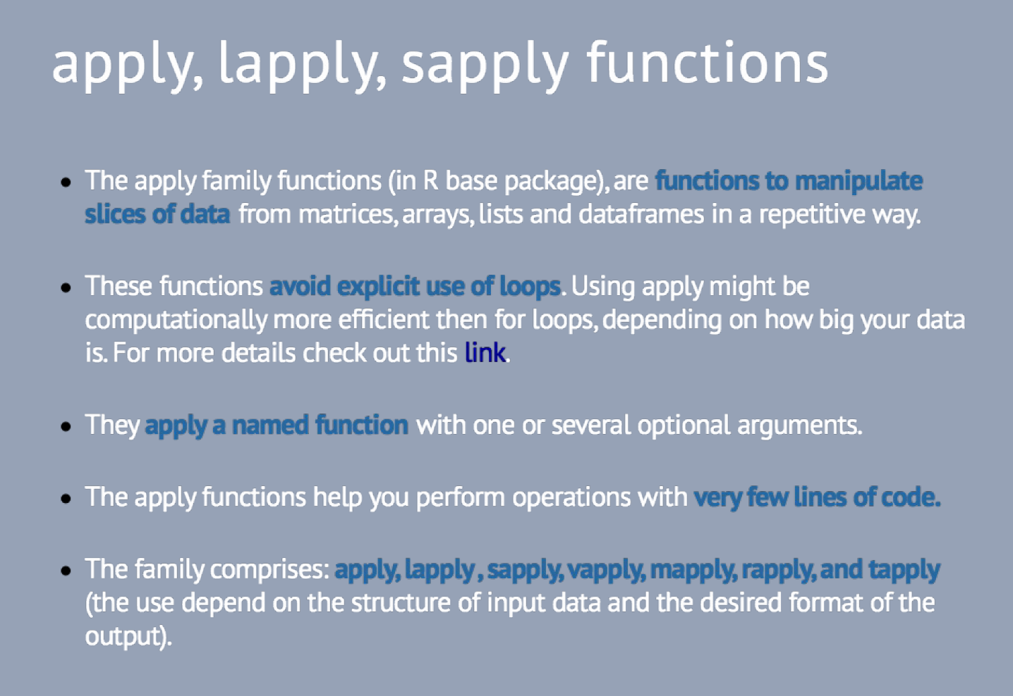

Slide 38
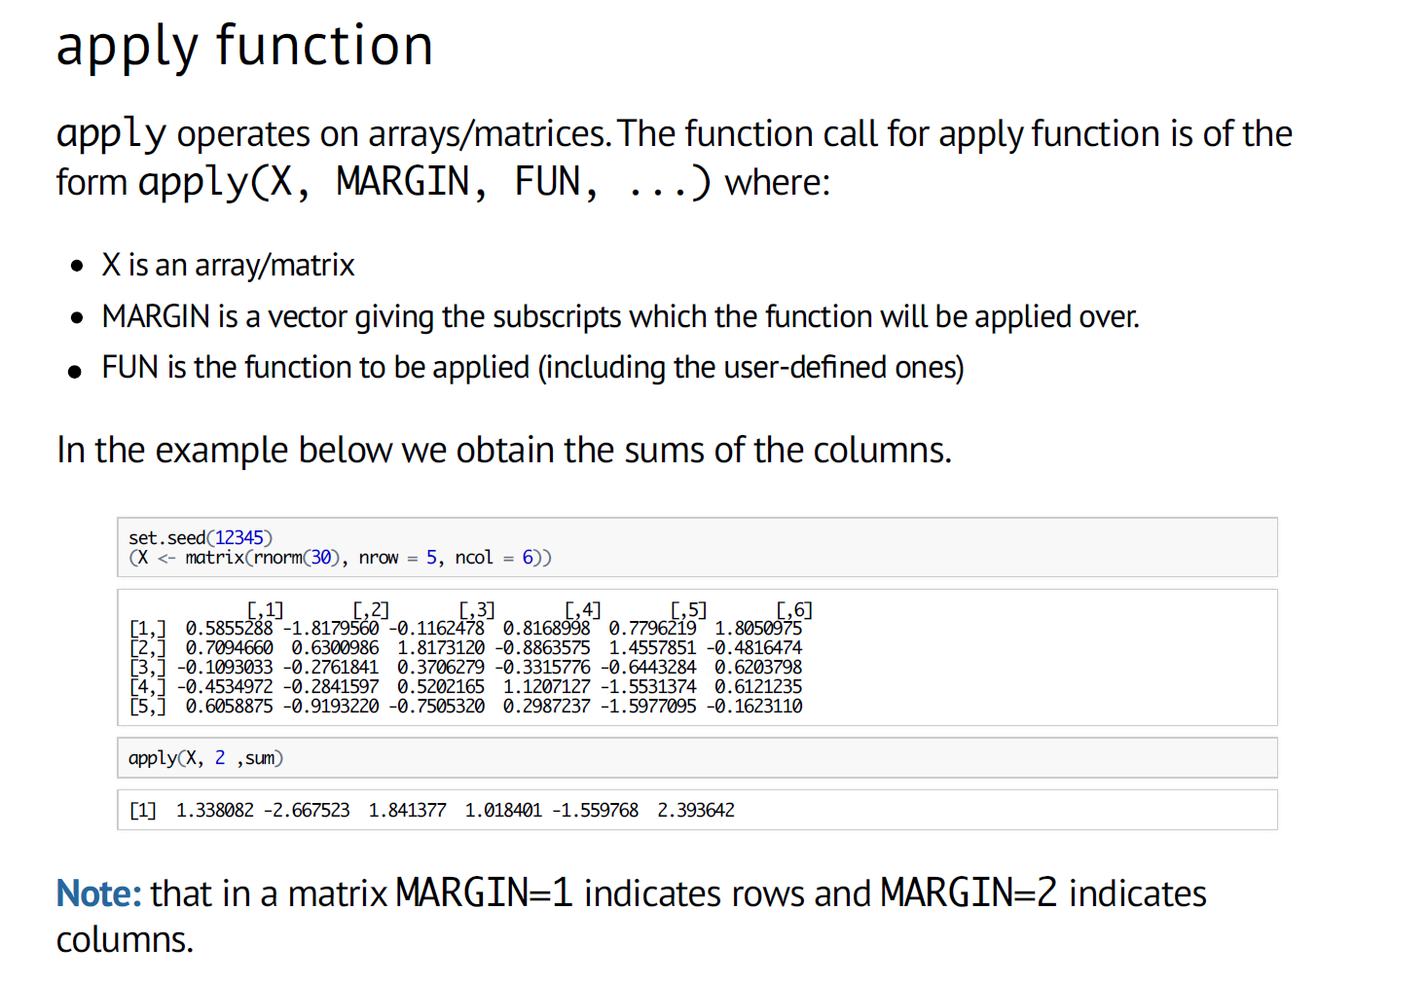

Slide 39
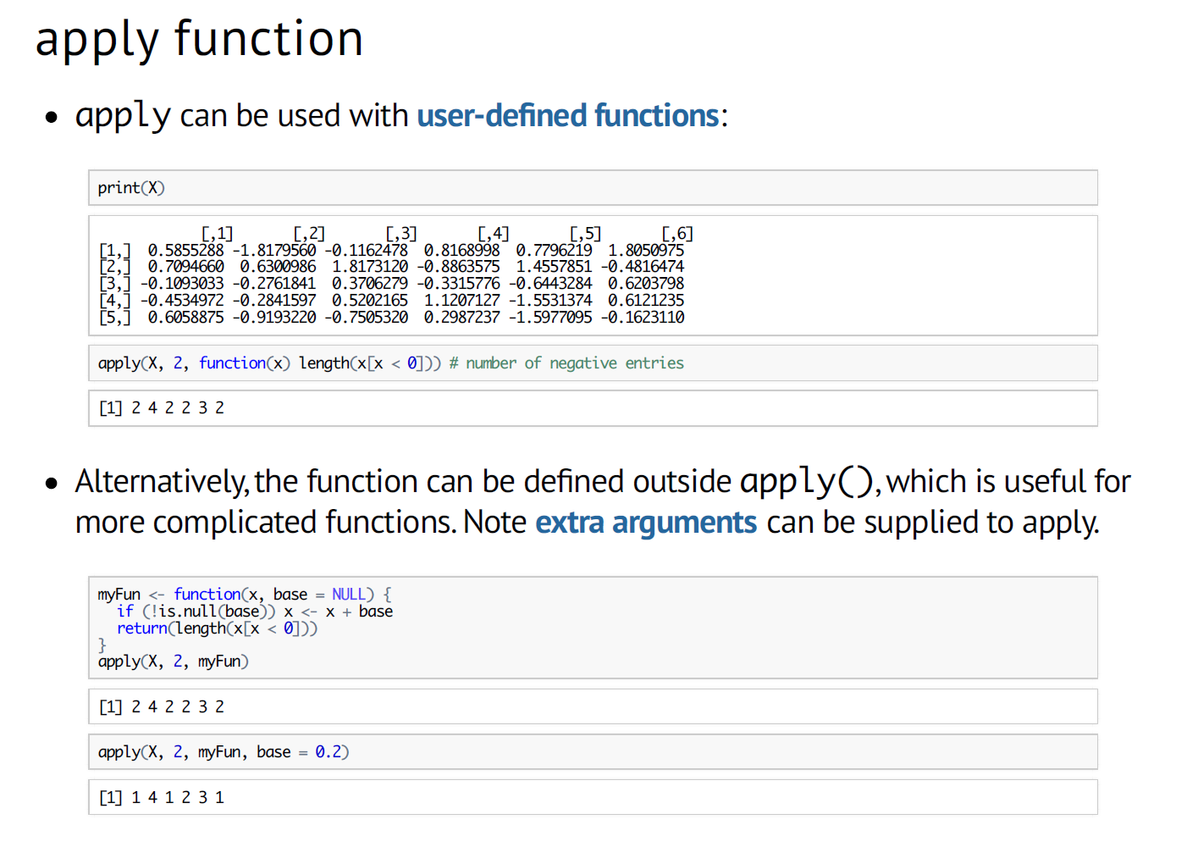

Slide 40
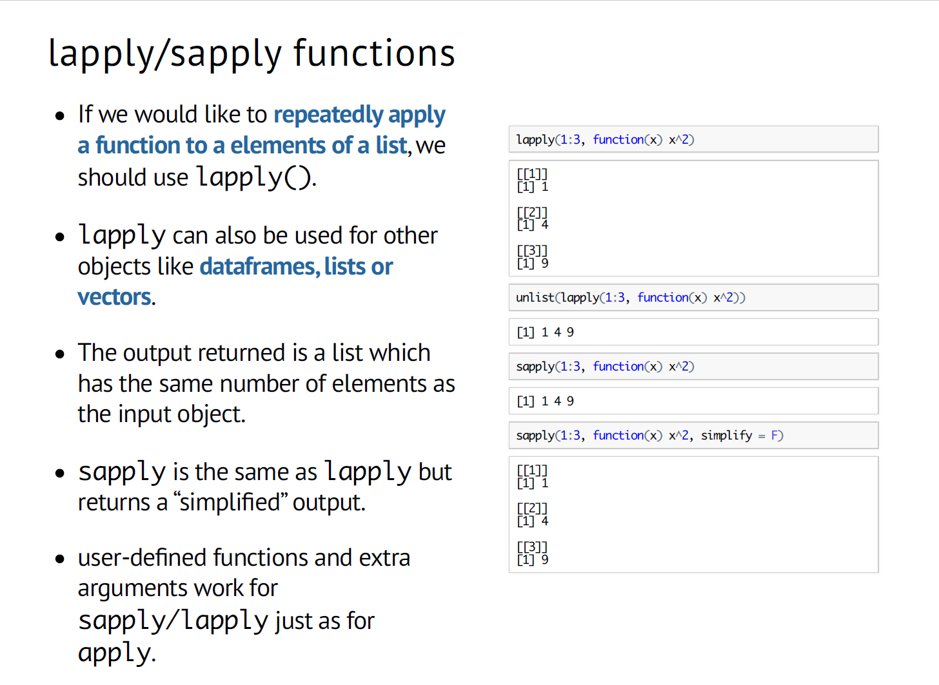

Slide 43
Check to see if a vector has all, any or a certain number of missing values. These create logical vectors which can be used to filter a matrix or data.frame

Slide 44
Data import/export

Slide 45
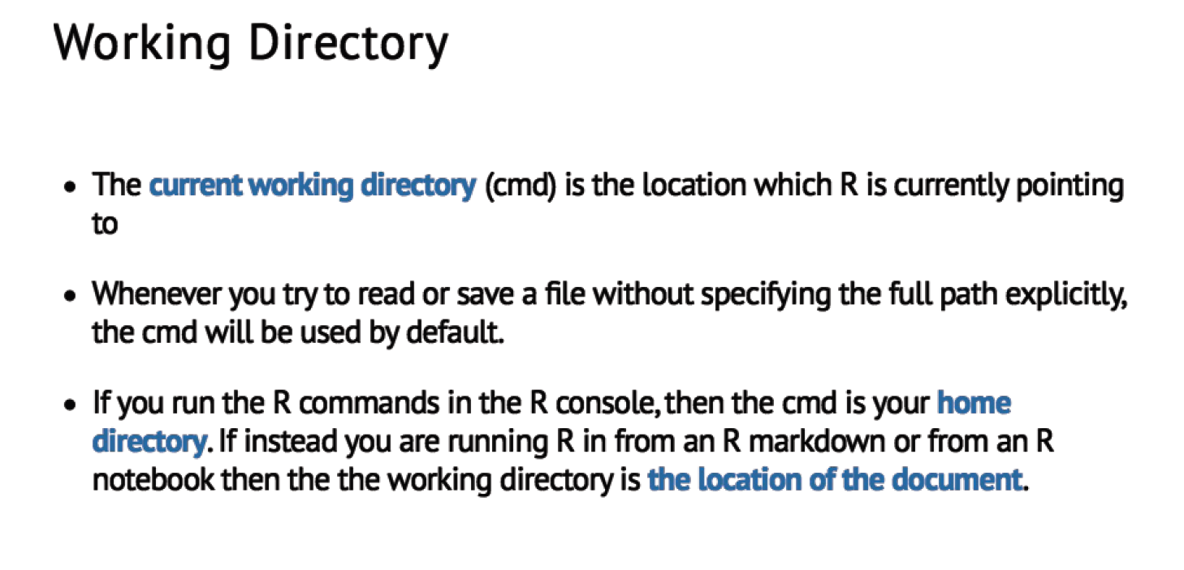

Slide 46
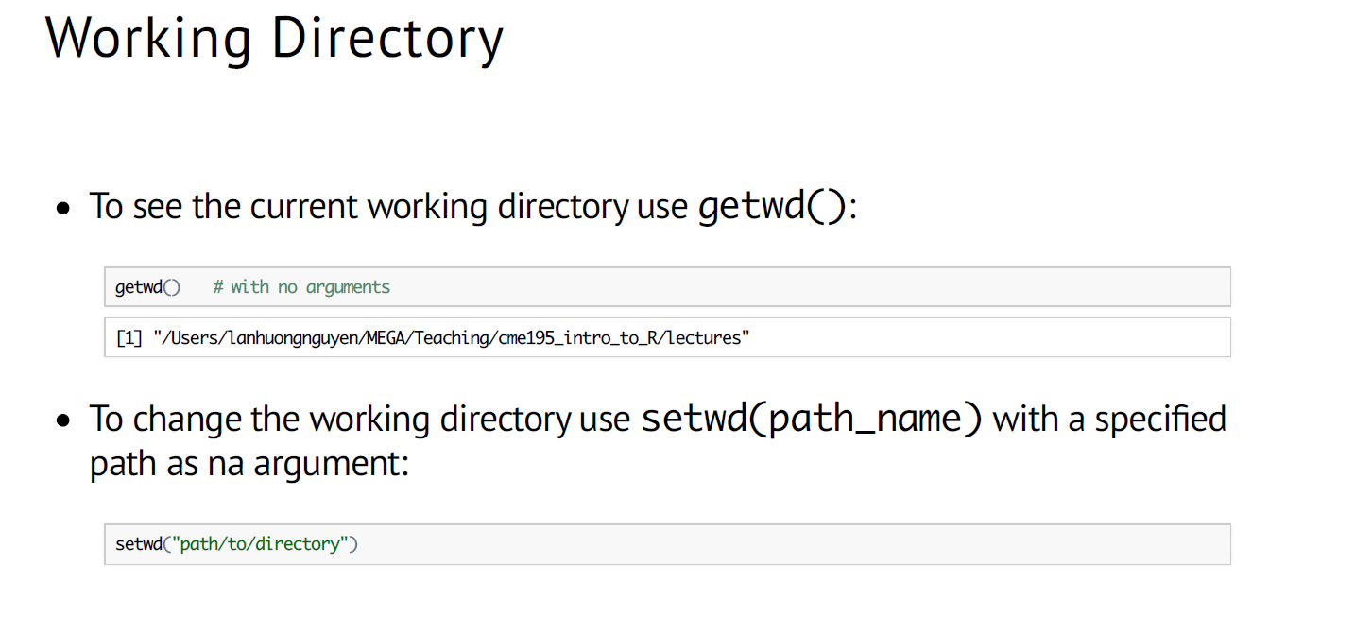

Slide 47
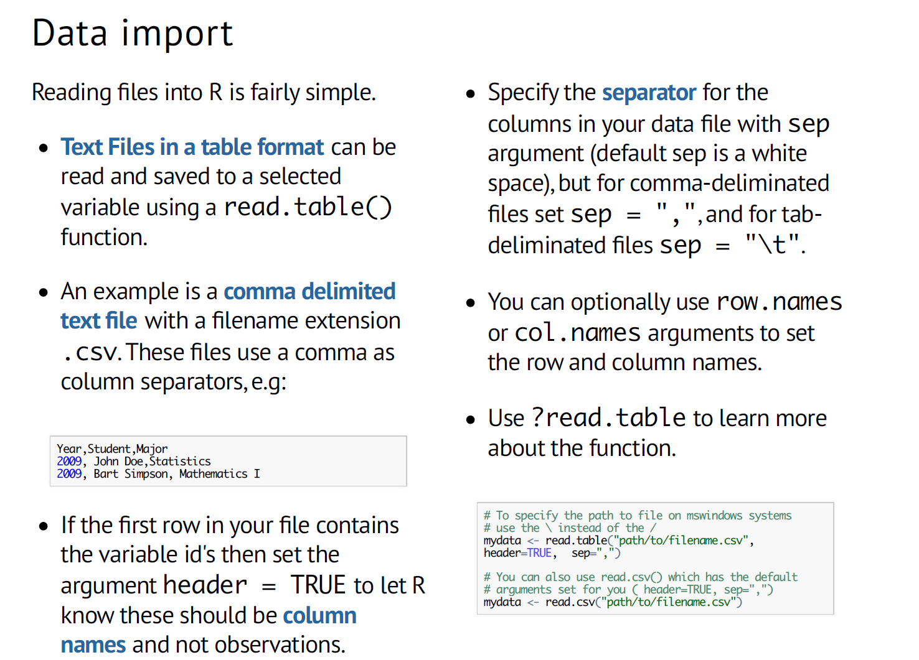

Slide 48
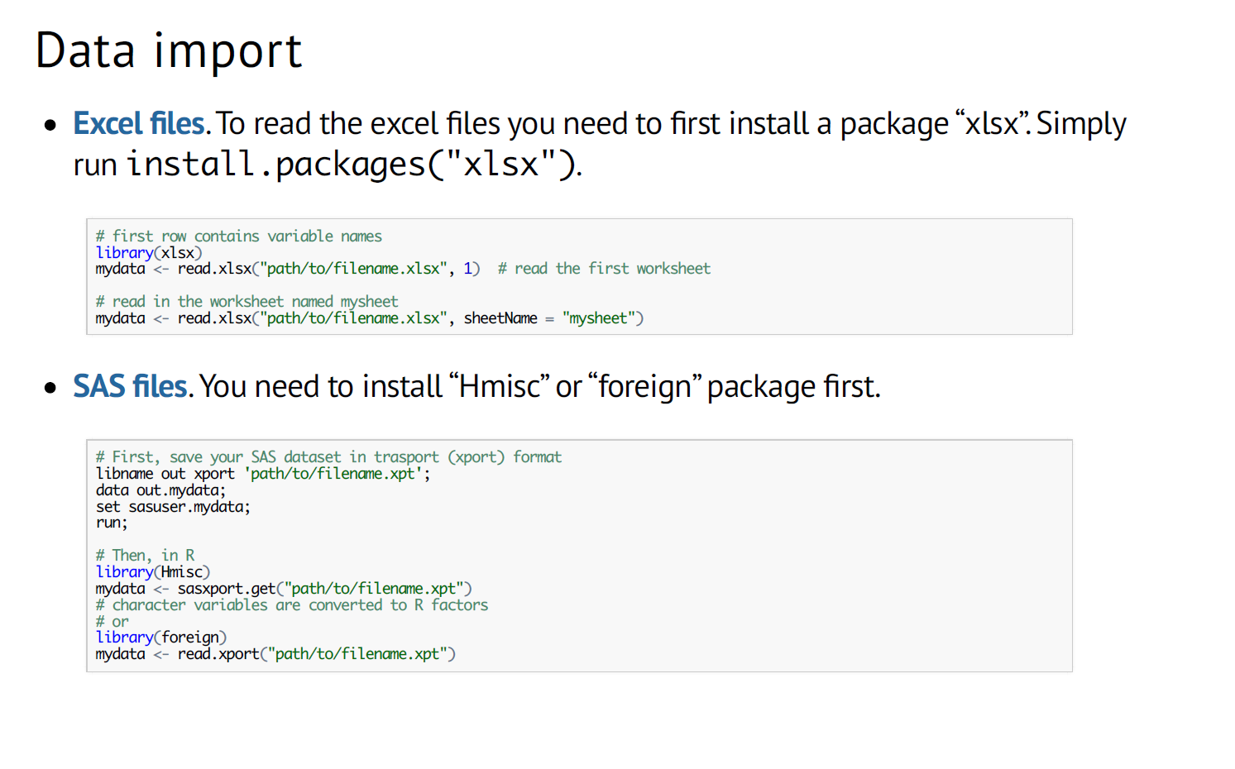

Slide 49
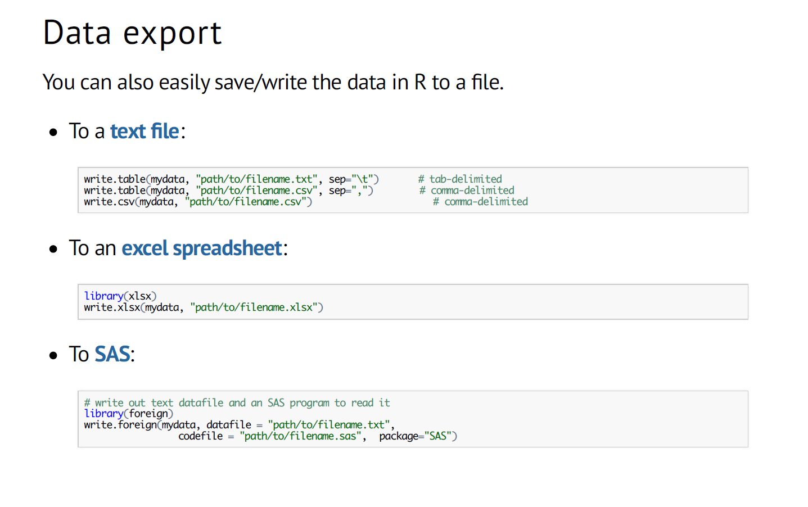

Slide 50
Read and inspect an example data file :
data.raw <- read.csv("./data/mx 107155 _lung cancer tissue_summer course_08-2015_submit.csv", header = F, stringsAsFactors = F)
head(data.raw)
data.raw[20,10] # inspecting the value of row number 20 and column number 10
data.raw[1:5,8:12] # inspecting the value of raw number 1 to 5 and column number 8 t 12
data.raw[,1] # first column – metabolite names
data.raw[1,] # first row – sample names
data.raw[10,] # class information
cpd.names <- data.raw[,1]
cpd.names[1:20]
# write an if statement to get the names of all the internal standards
for (i in cpd.names) {
if( length(grep('^z ',i)>0) ){
print(i)
}
}

Slide 51
# getting the row number and name of int standards.
for (i in 1:length(cpd.names)) {
if( length(grep('^z ',cpd.names[i])>0) ){
print(c(i,cpd.names[i]))
}
}
# lets get all the samples ids that has a label “tumor”
data.raw[1, grep("tumor",data.raw[10,] ) ]
# lets get all the columns that has sample data,
data.raw[1,grep("bbdsa", data.raw[1,])]
# we will use these extracted information on day 3.

Slide 52
Recap

Slide 53
